Slide 1
527 Data Analytics
January 28, 2016
U.S. Zip Code Analysis

Slide 2
Week # Topic: U.S. Zip Code Analysis Intro/Background
The term ZIP stands for Zoning Improvement Plan.
ZIP Code is used to signify a delivery route in the United States as designated by the United States Postal Service (USPS). Now, many other shipping companies such as United Parcel Service (UPS), Federal Express (FedEx), DHL, and others make use of ZIP codes for sorting packages and calculating the time and cost of shipping a package (the shipping rate).
This Zip Code data set which I use to analysis is from the website, http://www.unitedstateszipcodes.org/zip-code-database/. The data comes from authoritative sources such as the United States Postal Service (2011), US Census Bureau (2010), the Internal Revenue Service (2008), and Yahoo.
Active Zip Codes is the center that we care about because we use them right now. Hence, in this data analysis, we will find how many active Zip Codes in United States, which state has the most active Postal Codes and what geographic area has the most active Zip Codes in my hometown.

Slide 3
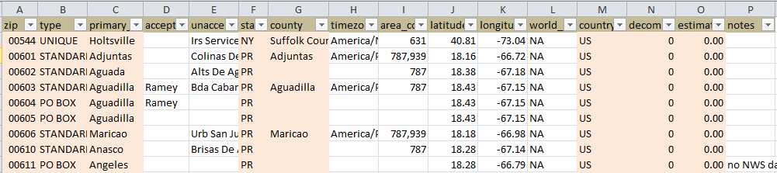
Week # Topic: U.S. Zip Code Analysis Intro/Background
There are 16 different data in this data set. I will choose 7 data of them to do analysis.
Zip is the basic unite to count when we use different filter to get different category
Use estimated_population to get the detail of estimation population in different category and help the analysis
Use decommissioned to get total active Zip Codes
Use type to classify different type of Zip Codes
Use country to figure out which Zip Codes belongs to the continental U.S.
Use state to get total active Zip Codes in different state
Use primary_city to target the geographic area which we want

Slide 4
Week # Topic: U.S. Zip Code Analysis Intro/Background
Statistics for the download file:
Total # of rows in file: 42522
Total # of Zip Codes in dataset: 42521
Total # of Zip Codes types in dataset: 4
Total # of states in dataset: 62
Total # of counties in dataset: 1913
Total # of countries in dataset: 54
Total # of decommissioned types in dataset: 2
Total # of estimated population in dataset: 240269342

Slide 5
Week # Topic: U.S. Zip Code Analysis Intro/Background
Zip: abbreviation for Zip Codes. The basic format for Zip Codes consists of five decimal numerical digits and we use this format in this dataset.
The first digit in this basic format generally represents a group of U.S. states. After adding following 2 digits, these 3 digits determine the central mail processing facility. The last 2 digits will tell postmen the local post offices.
In 1983, it was added an extended ZIP+4 code which determine a more specific location within a given ZIP code. However, it is not required, but it aids the post office in additional sorting of mail

Slide 6
Week # Topic: U.S. Zip Code Analysis Intro/Background
Type: There are four types of Zip Codes.
Unique: assigned to a single high-volume address
PO (Post Office) Box only: used only for PO Boxes at a given facility, not for any other type of delivery
Military: used to route mail for the U.S. military
Standard: all other ZIP codes

Slide 7
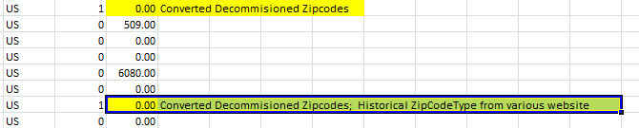
Week # Topic: U.S. Zip Code Analysis Intro/Background
Decommissioned: It represents this Zip Codes active or non-active. If the cell is 0, it means the Zip Code is still using. If the cell is 1, the following column, note will show some explanations and it means no use any more.

Slide 8
Week # Topic: U.S. Zip Code Analysis Intro/Background
Estimated_population: It represents the estimated population of this geographic region. Some case shows the estimated population is zero.
Country: In this data set, it shows 54 but we know it is U.S. Zip Codes and it should be one country, America.
State: States in the database are 62 and they are more than 50 states which Government defines.
County: some cells are empty.

Slide 9
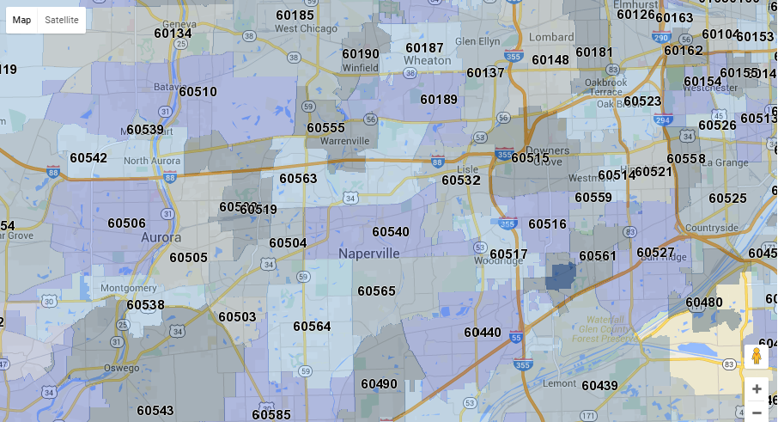
Week # Topic: U.S. Zip Code Analysis Intro/Background
These information is conflict with our understanding. The reason is the definition of Zip Codes “boundary” is different from the geographic boundary made by Government.
The original goal for ZIP Codes was to make mail delivery easier. In most cases a ZIP code is a geographic region with a center point. Sometimes, this geographic region can include more than one city, one county or one state. Or, some location for Military Zip Codes in another country.

Slide 10
Week # Topic: U.S. Zip Code Analysis Analysis
There are total 42521 Zip Codes. 41858 Zip Codes still use and 663 Zip Codes are not active.
As we see in this graph, active Zip Codes play the dominant role in the whole Zip Codes. Moreover, decommissioned Zip codes will not affect our life and nobody cares about them. Hence, I will focus on active Zip Codes.
Non-Active Zip Codes
2%
Unique
5%
Military
1%
PO Box
22%
Active Zip Codes
98%
Standard
71%

Slide 11
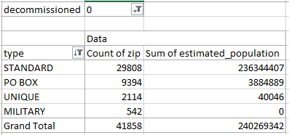
Week # Topic: U.S. Zip Code Analysis Analysis
Here is the graph and Pivot table for different type of active Zip Codes.
As we see in the graph, Standard is the most type which we often use and has the most numbers of Zip Codes.
Unique
5%
Military
1%
PO Box
22%
Standard
71%
Active Zip Codes

Slide 12
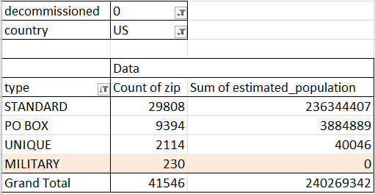
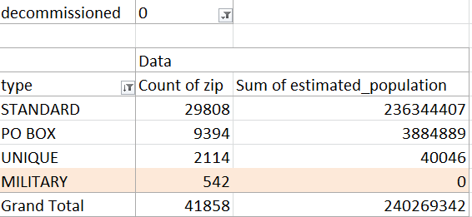
Week # Topic: U.S. Zip Code Analysis Analysis
If we add a filter of country, U.S., we will see the difference between these two Pivot table is the change of counting active Zip Codes for Military type. The number is 312.
Now, we can use another Pivot table to see where these 312 Zip Codes come from.

Slide 13
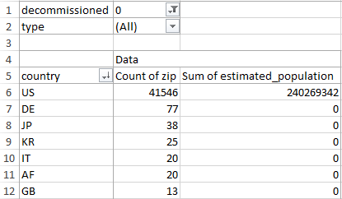
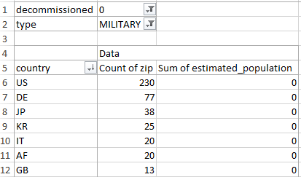
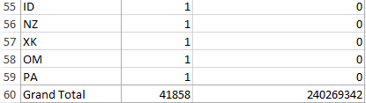
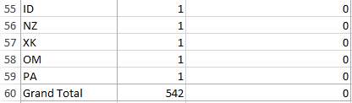
Week # Topic: U.S. Zip Code Analysis Analysis
During 41858 active Zip Codes, there are 41546 active Zip Codes in American homeland and 312 active codes in other 53 countries.

Slide 14
Week # Topic: U.S. Zip Code Analysis Analysis
Through comparing these two Pivot tables, we can see these Zip Codes in other countries are all military type. It matches the previous comparison in type of Pivot tables.
Using the filter of Military type, we can get the layout of American oversea troops. They are in 53 different countries.
 | United States | Overseas (other countries) | Total count of Zip Codes
count of Zip Codes for All types | 41546 | 312 | 41858
count of Zip Codes for Military type | 230 | 312 | 542

Slide 15
Week # Topic: U.S. Zip Code Analysis Analysis
Here is the rank list of Top 15 for active U.S. Zip codes in different countries.
Country | Count of zip | Sum of estimated_population | Rank
US (America) | 41546 | 240269342 | 1
DE (Gemany) | 77 | 0 | 2
JP (Japan) | 38 | 0 | 3
KR (Korea, Rupublic of Kuwait) | 25 | 0 | 4
IT (Italy) | 20 | 0 | 5
AF (Afghanistan) | 20 | 0 | 6
GB (United Kingdom) | 13 | 0 | 7
IQ (Iraq) | 9 | 0 | 8
KW (Kuwait) | 7 | 0 | 9
BE (Belgium) | 7 | 0 | 10
BH (Bahrain) | 6 | 0 | 11
TR (Turkey) | 6 | 0 | 12
AU (Australia) | 5 | 0 | 13
TH (Thailand) | 5 | 0 | 14
NL (Netherlands) | 5 | 0 | 15

Slide 16
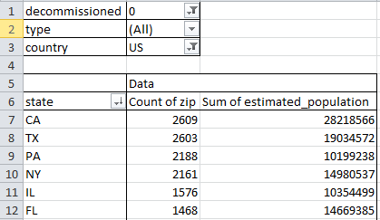
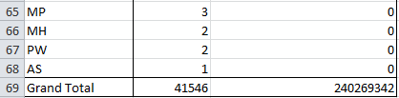
Week # Topic: U.S. Zip Code Analysis Analysis
Here is the Pivot table for different
States in American homeland. As we see,
there are more than 50 states in this table.

Slide 17
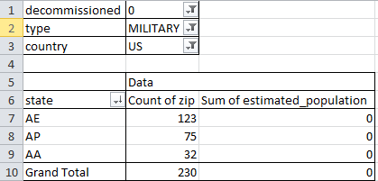
Week # Topic: U.S. Zip Code Analysis Analysis
After we add the filter of military, we can only see three states on this table. They are AE, AP and AA. They all represent Military “State”.
AE: Armed Forces Africa, Armed Forces Canada, Armed Forces Europe and Armed Forces Middle East.
AP: Armed Forces Pacific.
AA: Armed Forces Americas.

Slide 18
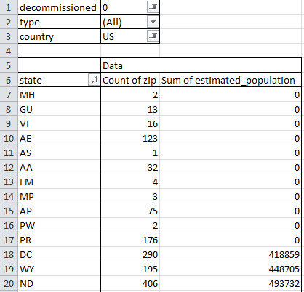
Week # Topic: U.S. Zip Code Analysis Analysis
After sorting the sum of estimated
population in ascending order, we will
see 9 more states which are not including
in the 50 states. They belong to
commonwealth/Territory.
MH: Marshall Islands
GU: Guam
VI: Virgin Islands
AS: American Samoa
FM: Federated States of Micronesia
MP: Northern Mariana Islands
PW: Palau
PR: Puerto Rico
DC: District of Columbia

Slide 19
Week # Topic: U.S. Zip Code Analysis Analysis
Here is the TOP 15 rank list to count active Zip Codes in different states. As we see, California is No. 1 and has 2609 active Zip Codes. My home state, Illinois list No. 5.
State | Count of zip | Sum of estimated_population | Rank
CA | 2609 | 28218566 | 1
TX | 2603 | 19034572 | 2
PA | 2188 | 10199238 | 3
NY | 2161 | 14980537 | 4
IL | 1576 | 10354499 | 5
FL | 1468 | 14669385 | 6
OH | 1422 | 9191577 | 7
VA | 1218 | 6349050 | 8
MI | 1160 | 7864914 | 9
MO | 1157 | 4650892 | 10
NC | 1080 | 7322452 | 11
IA | 1056 | 2388807 | 12
MN | 1023 | 4324218 | 13
IN | 975 | 5214293 | 14
GA | 955 | 7540717 | 15

Slide 20
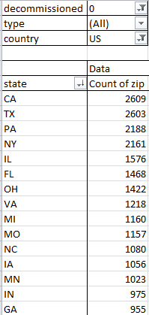
Week # Topic: U.S. Zip Code Analysis Analysis
Here is a column graph of Top 15 state to count active Zip
Codes in American homeland.
Unit:
count of
active
Zip Codes
State Name:

Slide 21
Week # Topic: U.S. Zip Code Analysis Analysis
Here is the histogram of Top 15 state of counting active Zip
Codes in American homeland. As we see, the most frequently
number of total active Zip Codes is in the range from 900 to
1080. It means there are 5 states’ total number of Zip Codes
is in this range.
Frequency
Bin: count of
active Zip Codes

Slide 22
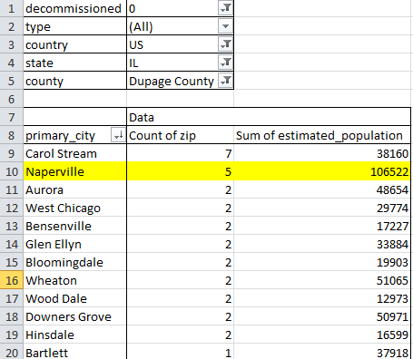
Week # Topic: U.S. Zip Code Analysis Analysis
Now, we narrow down the scope of
geographic area and look at my
hometown, Naperville.
In this Pivot table, when we search all
types of active Zip Codes, Carol Stream
has the most count of active Zip Codes
in my home county, DuPage county.
Naperville is No. 2 in the list.

Slide 23
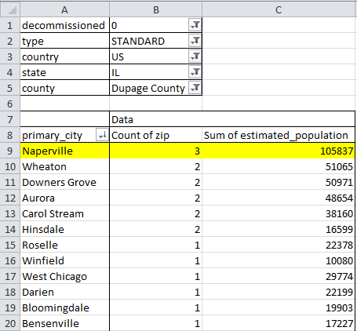
Week # Topic: U.S. Zip Code Analysis Analysis
When we change the filter of all type
to standard which we use mostly and
commonly, Naperville become the most
count of active Zip Codes in my home
county, DuPage county.

